Slide 1
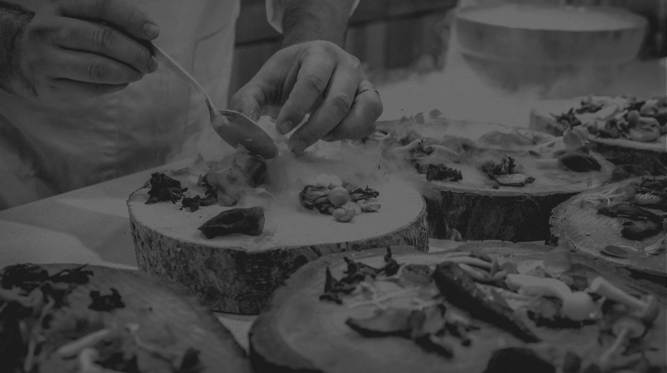
iOrder
BY
MICILLO SIMONE
PERROTTA DAVIDE
LANZUISE FABRIZIO

Slide 2

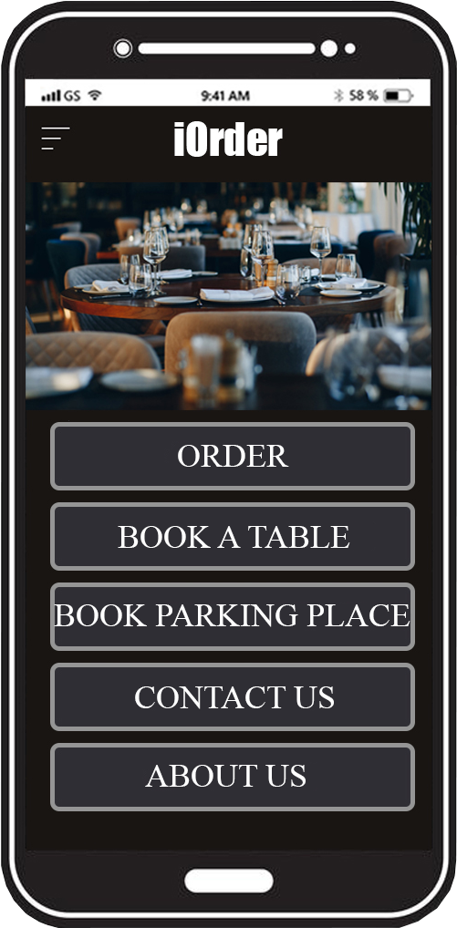
What’s iOrder?
The objectives
iOrder is a platform for the organization
of catering activities;
It’s completely dedicated to the customers;
It offers different services aimed
to improve the customer experience.
1

Slide 3
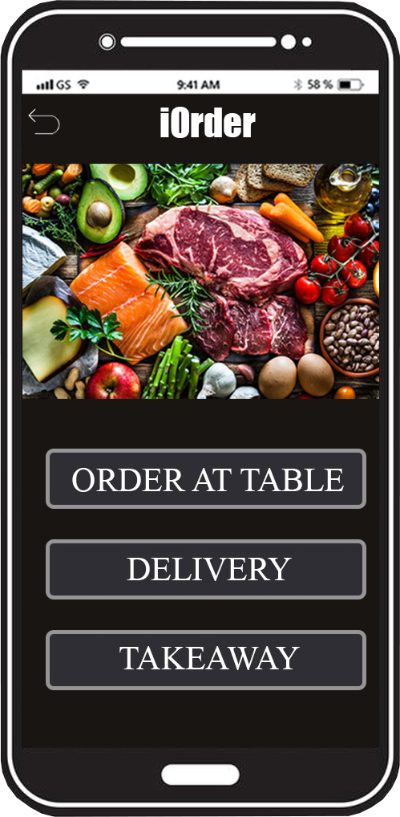
What iOrder can do?
The Features
Order
AT THE TABLE
TAKEAWAY
DELIVERY (with its estimated time)
2

Slide 4
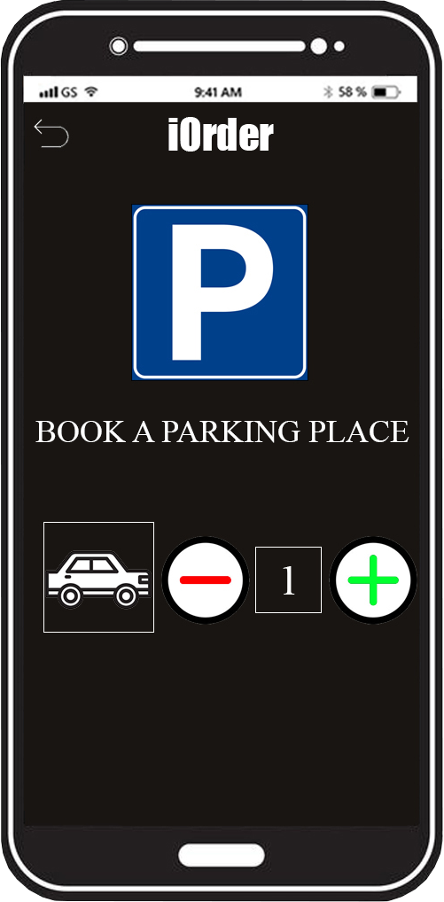
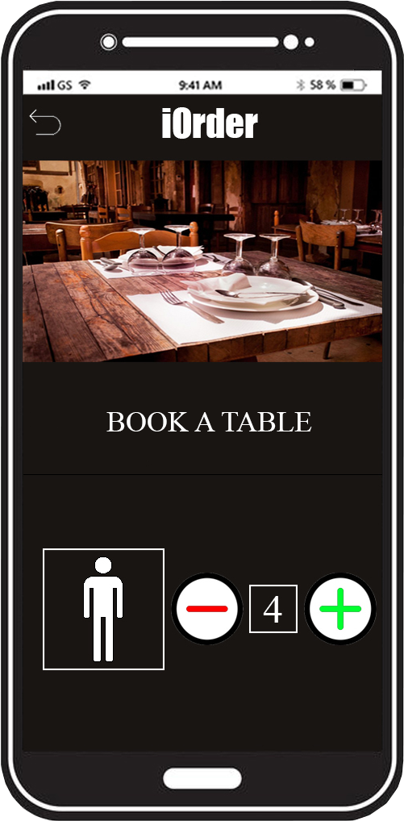


What iOrder can do?
The Features
Booking
TABLE AT RESTAURANT
PARKING SPACE
3

